Slide 1
Cloud Task Scheduling using machine learning algorithms
PROJECT GUIDE- DR. Punit Gupta
BY-
Sandesh Murdia (199303072)
Rajat Saxena (199303182)

Slide 2
What is cloud ?
Cloud refers to software or we can say services which runs on the Internet, rather than locally on your computer.
Examples- Google Drive, Apple iCloud, Microsoft OneDrive etc.
The cloud enables users to access the same files and applications from almost any device in the world, because everything in the cloud takes place on servers in a data center, instead of locally on the user device.

Slide 3
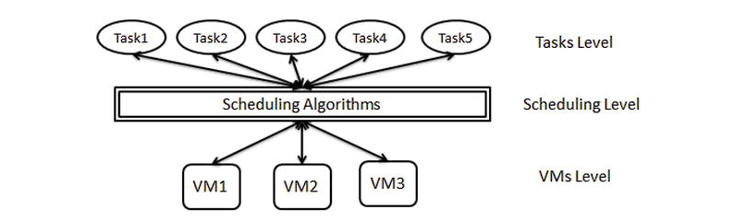
What is cloud task scheduling ?
Task scheduling is the process of arranging incoming requests (tasks) in a certain manner so that the available resources will be properly utilized.
To minimize the task execution cost & time, one needs to schedule tasks onto their most suitable VMs for execution.

Slide 4
Problem statement
Cloud computing deals with different kinds of virtualized resources, hence scheduling places an important role in cloud computing. In cloud user may use hundred of thousands of virtualized resources for each user task. So manual scheduling is not a feasible solution. Therefore, an optimized task scheduling algorithm is needed to find the most optimal solution.

Slide 5
Existing Models
A WOA-Based Optimization Approach for Task Scheduling in Cloud Computing Systems
A PSO Algorithm Based Task Scheduling in Cloud Computing
Task Scheduling in Cloud Computing Based on Hybrid Moth Search Algorithm and Differential Evolution
A WOA-Based Optimization Approach for Task Scheduling in Cloud Computing Systems
Amelioration of task scheduling in cloud computing using crow search algorithm
Chaotic social spider algorithm for load balance aware task scheduling in cloud computing
An EDA-GA Hybrid Algorithm for Multi-Objective Task Scheduling in Cloud Computing

Slide 6
Proposed solution
Finding an optimal solution for cloud task scheduling using a machine learning algorithm.
Comparing with another machine learning algorithm
Will work on parameter like Total execution time, population size, VM
Conclude that the algorithm is Good or Bad.

Slide 7
Algorithms
PROPOSED ALGORITHM - Elephant Herd Optimization
ALGORTIHM USED FOR COMPARSION – Particle Swarm Optimization

Slide 8
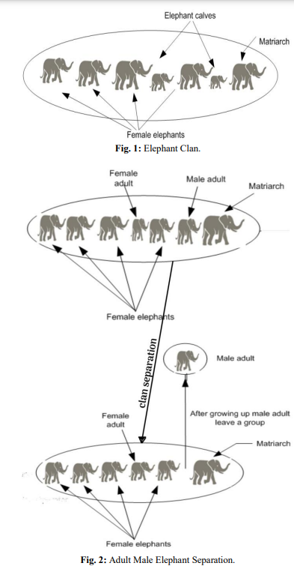
Elephant HERD OPTIMIZATION
Elephant Herding optimization algorithm (EHO) is a metaheuristic swarm based search algorithm, which is used to solve various optimization problems.
Elephants live in a clan with a leader matriarch (Female elephant), while the male elephants separate from the group when they reach adulthood. This is used in the algorithm in two parts.
a) Clan update (which updates the elephants and matriarch current positions in each clan). b) Separation (which enhances the population diversity in the next search phase).
In EHO method, the adult male elephant with the worst efficiency separates at each generation.

Slide 9
particle SWARM OPTIMIZATION
Suppose there is a swarm (a group of birds). Now, all the birds are hungry and are searching for food. These hungry birds can be correlated with the tasks in a computation system which are hungry for resources.
Now, in the locality of these birds, there is only one food particle. This food particle can be correlated with a resource. As we know, tasks are many, resources are limited. So this has become a similar condition as in a certain computation environment.
The birds don’t know where the food particle is hidden or located. In such a scenario, how the algorithm to find the food particle should be designed. If every bird will try to find the food on its own, it may cause havoc and may consume a large amount of time. Thus on careful observation of this swarm, it was realized that though the birds don’t know where the food particle is located, they do know their distance from it.
Thus the best approach to finding that food particle is to follow the birds which are nearest to the food particle. This behavior of birds is simulated in the computation environment and the algorithm so designed is termed as Particle Swarm Optimization Algorithm.

Slide 10
Tools Required
Cloud-Sim 3.0
NetBeans
Python

Slide 11
Cloudsim
CloudSim Simulation Tool is the most popular simulator used by researchers and developers nowadays for the cloud-related issues in the research field.
CloudSim is an open-source framework, which is used to simulate cloud computing infrastructure and services. It is developed by the CLOUDS Lab organization and is written entirely in Java. It is used for modelling and simulating a cloud computing environment as a means for evaluating a hypothesis prior to software development in order to reproduce tests and results.

Slide 12
Mealpy (PYTHON library used)
MEALPY is a Python library for the most of cutting-edge population meta-heuristic algorithms - a field which provides a fast and efficient way to find the global optimal point of mathematical optimization problems.
Population meta-heuristic algorithms (PMA) are the most popular algorithm in the field of optimization. There are several types of PMA such as:
1. Evolutionary inspired computing
2. Swarm inspired computing
3. Physics inspired computing
4. Human inspired computing
5. Biology inspired computing
6. And others such as: Music inspired, Mathematical inspired computing.

Slide 13
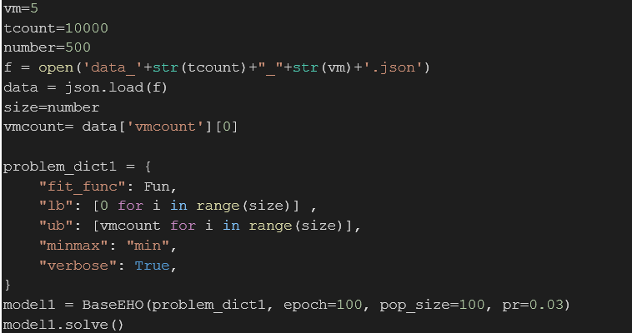
Fitness function

Slide 14
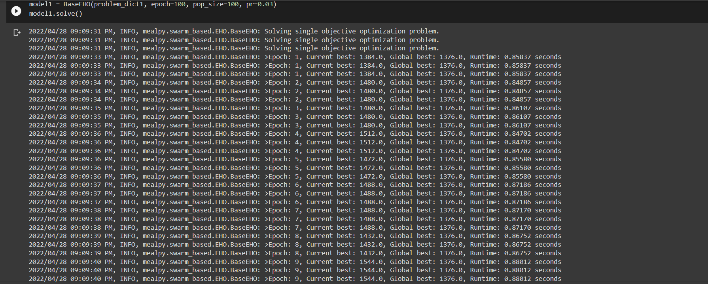
CODE output

Slide 15
Parameters used for comparison
Execution time
Population
No. of task
No. of VM
Epoch

Slide 16
Comparison of execution time (global best)
When VM=5
When VM=5
Epoch | Population Size | No. of Task | Global Best (EHO) | Global Best (PSO)
100 | 100 | 100 | 112 | 95.9
100 | 100 | 500 | 192 | 571
100 | 100 | 1000 | 824 | 1187
100 | 100 | 1500 | 992 | 1733
100 | 100 | 2000 | 2272 | 2318
100 | 100 | 2500 | 2352 | 2816
100 | 100 | 3000 | 368 | 3550
Findings-
After comparing the dataset by testing it with increasing no. of tasks and by keeping other parameters same we observed that when the resources were less like in VM=5 table EHO gave better results compared to PSO but when tasks were very less(appx.100) PSO was better.
But when the resources were more like in VM=10 table we didn’t saw much difference in our results so when resources are more both the algorithms gave good results.
Comparing both the tables we can say using EHO is good.
When VM=10
Epoch | Population Size | No. of Task | Global Best (EHO) | Global Best (PSO)
100 | 100 | 100 | 62.8 | 64
100 | 100 | 500 | 336 | 300
100 | 100 | 1000 | 639.9 | 611
100 | 100 | 1500 | 952 | 902
100 | 100 | 2000 | 1280 | 1228
100 | 100 | 2500 | 1664 | 1540
100 | 100 | 3000 | 2040 | 1714

Slide 17
Comparison of execution time (global best)
When VM=5
Epoch | Population Size | No. of Task | Global Best (EHO) | Global Best (PSO)
100 | 100 | 500 | 192 | 563.4
100 | 200 | 500 | 628 | 524
100 | 300 | 500 | 616 | 524.57
100 | 100 | 1500 | 992 | 1838.85
100 | 200 | 1500 | 2040 | 1747
100 | 300 | 1500 | 2088 | 1588
Findings-
When we increase the population size in both the algorithm we didn’t saw any major change in the global best. Only when population size was less in 5 VM we saw some differences in EHO.
When VM=10
Epoch |  | Population Size | No. of Task | Global Best (EHO) | Global Best (PSO)
100 |  | 100 | 500 | 336 | 305.14
100 |  | 200 | 500 | 308 | 301
100 |  | 300 | 500 | 314 | 297
100 |  | 100 | 1500 | 952 | 908.57
100 |  | 200 | 1500 | 976 | 920
100 |  | 300 | 1500 | 937 | 913

Slide 18
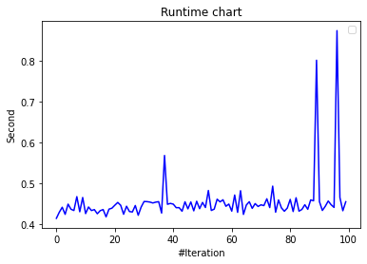
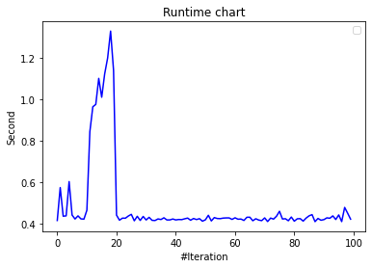
Comparing Elephant herd optimization VS Particle swarm optimization by Visualizing–
ELEPHANT HERD OPTIMIZATION
PARTICLE SWARM OPTIMIZATION

Slide 19
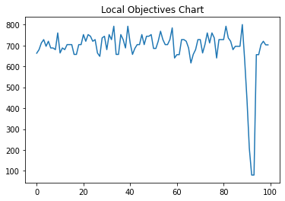
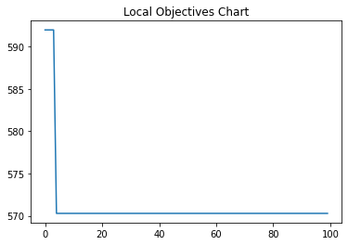
Comparing Elephant herd optimization VS Particle swarm optimization by Visualizing–
ELEPHANT HERD OPTIMIZATION
PARTICLE SWARM OPTIMIZATION

Slide 20
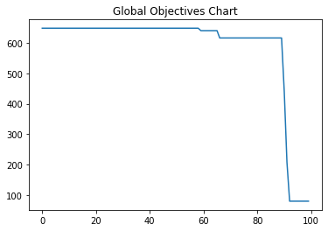
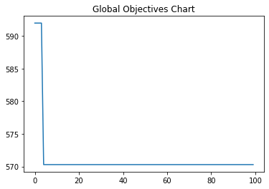
Comparing Elephant herd optimization VS Particle swarm optimization by Visualizing–
ELEPHANT HERD OPTIMIZATION
PARTICLE SWARM OPTIMIZATION

Slide 21
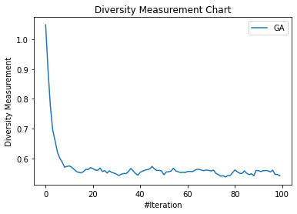
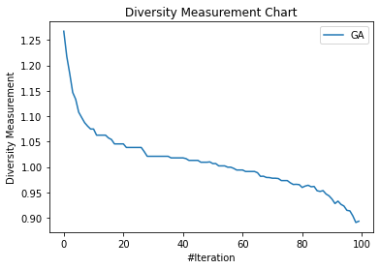
Comparing Elephant herd optimization VS Particle swarm optimization by Visualizing–
ELEPHANT HERD OPTIMIZATION
PARTICLE SWARM OPTIMIZATION

Slide 22
CONCLUSION
We conclude that EHO has a good characteristics as optimization algorithm and it can be used for solving complex optimizations problems.

Slide 23
Thank You

